Slide 1
Ticket #324 Reading
Clarify MPI_ERRORS_ARE_FATAL scope of abort
https://svn.mpi-forum.org/trac/mpi-forum-web/ticket/324
Fault Tolerance Working Group
June 3, 2015

Slide 2
Background
Section 8.3 is imprecise about where MPI_ERRORS_ARE_FATAL is applied.
The first and second sentences are contradictory (MPI_ABORT accepts a communicator argument)
The second sentence is more permissive for FT implementations and good software engineering.

Slide 3
Motivation
Allows the application to clean itself up after an error.
Flush state to disk, close files, etc.
Step 0 for any FT solution
Could be part of ULFM, but this is more generic than that solution.
Allows very basic FT implementations and applications
Without these changes, if any communicator uses MPI_ERRORS_ARE_FATAL, all use it.

Slide 4
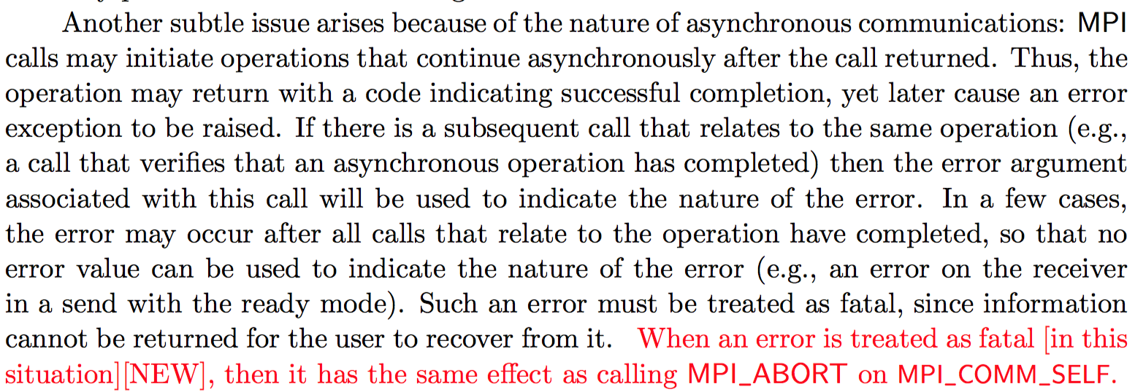
Text Changes
Section 2.8
Clarify that a generic fatal error is the same as calling MPI_ABORT(MPI_COMM_SELF)

Slide 5
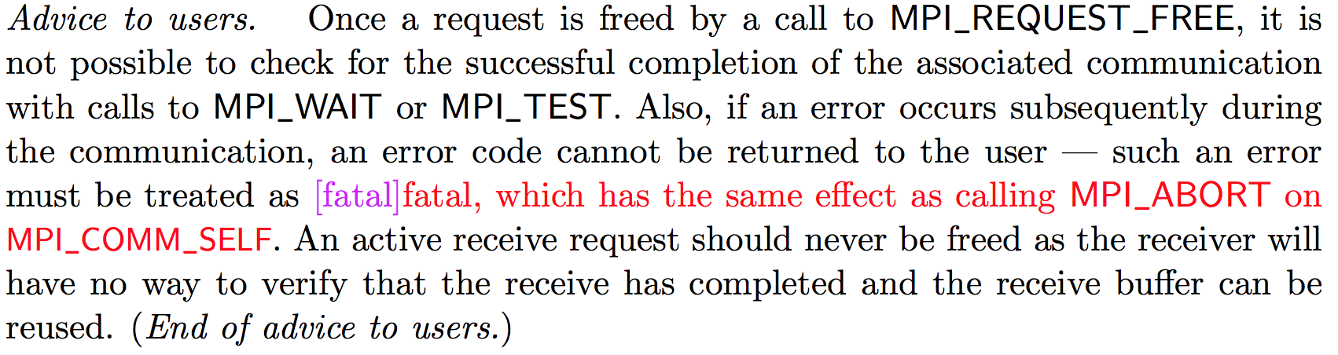
Text Changes
Section 3.7.3
Definition of MPI_REQUEST_FREE
Continue clarification from previous change

Slide 6
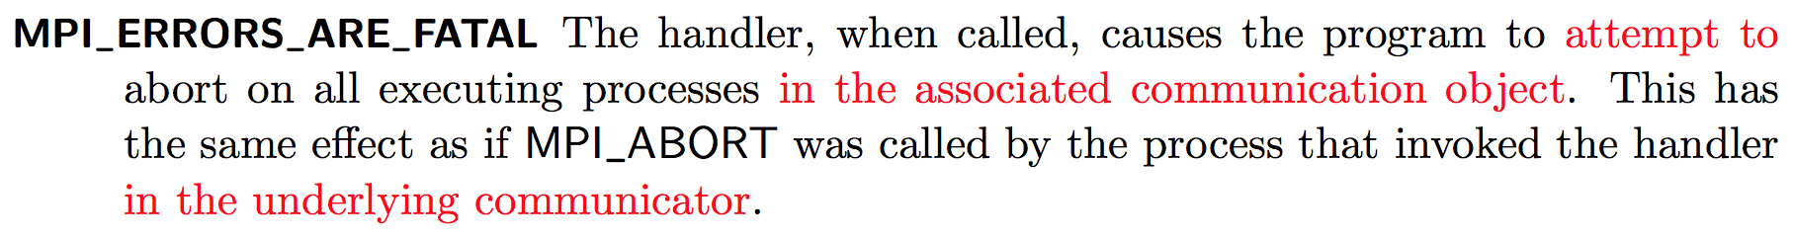
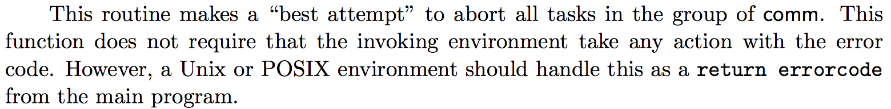
Text Changes
Section 8.3
Definition of MPI_ERRORS_ARE_FATAL
Define the scope of abort for error handler to just the current communicator
Definition of MPI_ABORT

Slide 7
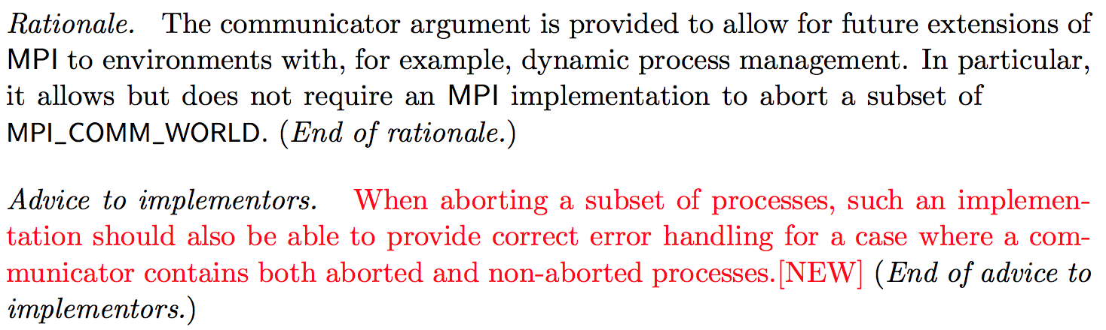
Text Changes
Section 8.7
Definition of MPI_ABORT
Add advice to say that implementations should provide a graceful way of dealing with aborted processes.

Slide 8
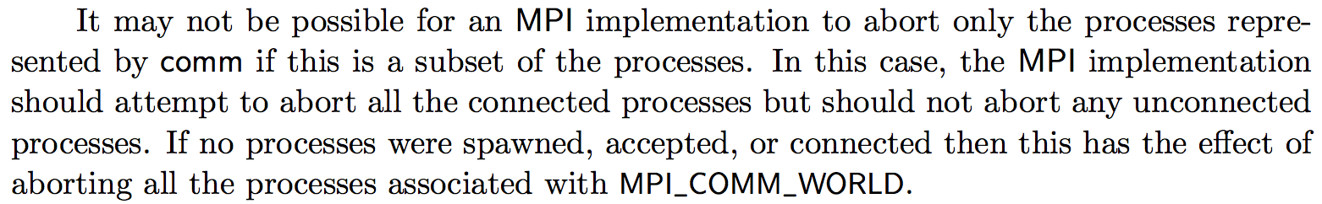
Previous Objections
This prevents the application from handling an exception safely! (MPI_SEND kills apps)
If you want to be safe, set your error handler to MPI_ERRORS_RETURN on communicators that you want to keep alive.
Completing MPI_SEND does not imply that the message has been received (or that the receiver is alive).
This has a large burden on implementations!
This is just as optional as FT has always been. Feel free to abort.

Slide 9
Burden on Implementations
No new implementation required
Implementations are still free to abort on errors
Implementations that choose to do better now have clear instructions

Slide 10
Implementation
MPICH
Needs a patch to abort a subset instead of MPI_COMM_WORLD
In the review process
Other infrastructure has been present since v3.0
Open MPI
Runtime doesn’t support continuing with a subset of processes
Notes:
Internally, it may be necessary for an implementation to notify all communicators about an abort in order to cleanup correctly.

Slide 11
Backup Slides

Slide 12
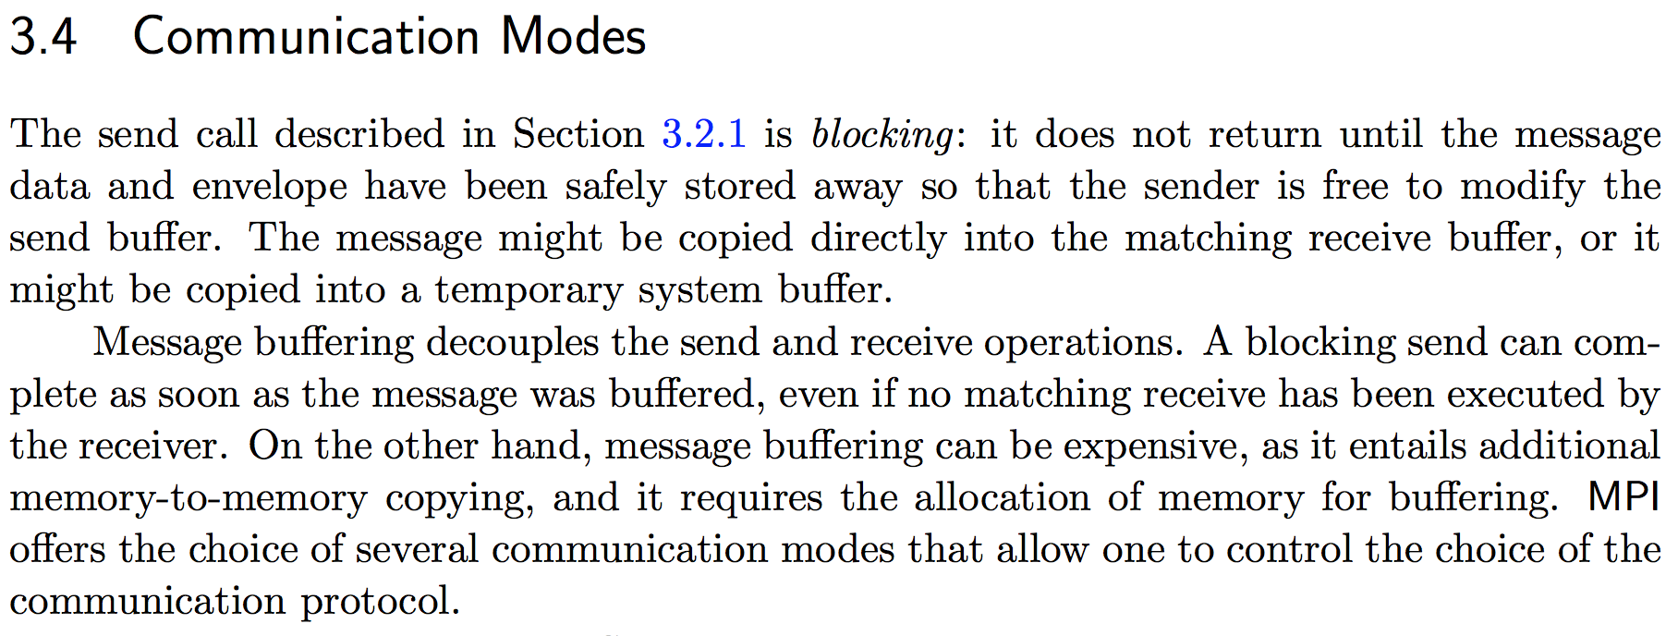
Why MPI_Send can succeed when the receiver is dead
Returning from MPI_Send does not imply that the message is received, only buffered somewhere.

